Slide 1
Crisis Track and Hurricane Response
Notes:
For full section of Slide Options, click “New Slide” dropdown menu under the Home tab.

Slide 2
Agenda
Introduction
Emergency Response Centers
Crisis Track Implementation
2024 Hurricanes
Closing

Slide 3
Introduction
Riley Tuff, Lead Emergency Planner
Bachelors in Public Administration, UCF
Masters in Social Work, USC
Former Roles
Seminole County
Walt Disney World Resort
City of Cape Coral
Using Crisis Track since 2019

Slide 4
Emergency Response Centers
ERC #1 - Tampa Bay ES - 3111 Tampa Bay Boulevard Tampa, FL
ERC #2 Forest Hills ES - 10112 North Ola Avenue Tampa, FL 33612
ERC #3 Oak Park ES - 2716 North 46th Street Tampa, FL 33605

Slide 5
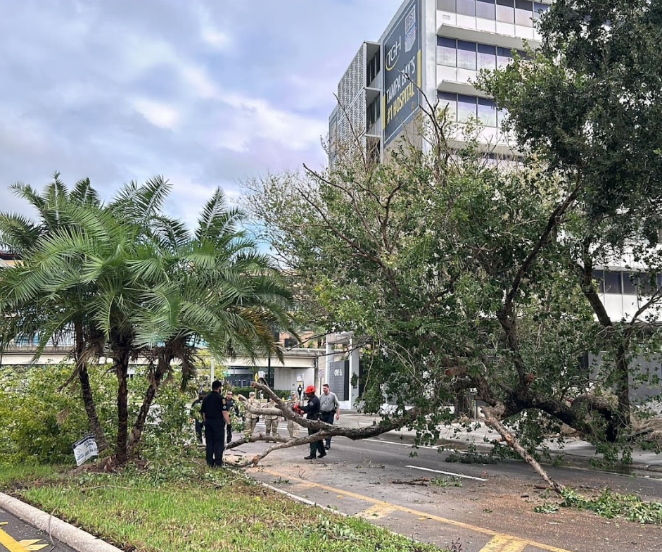
ERC Functions
Push Crew
Initial Push – Identify Major Hazards
Blocked Roads
Downed Tree/Powerlines
Disabled Traffic Lights
Public Damage Assessment
City Buildings
Private Damage Assessment
Residential/Commercial

Slide 6
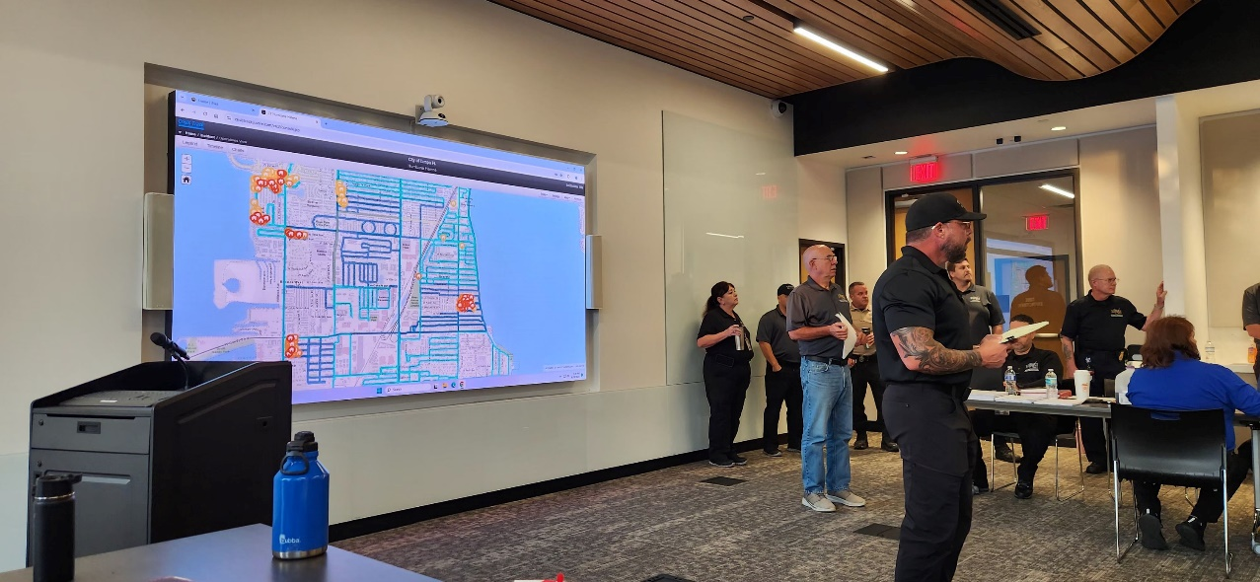
Crisis Track Implementation
Build Infrastructure to meet needs of missions
Preconfigured Teams
Preconfigured Tasks
Keep it simple!

Slide 7
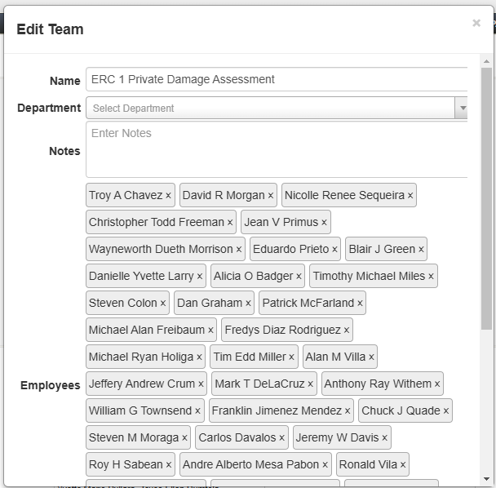
Preconfigured Teams
All ERC’s have 3 Preconfigured Teams
Push Crew
Public Damage Assessment
Private Damage Assessment
Assign Appropriate ERC Staff to each Team.

Slide 8
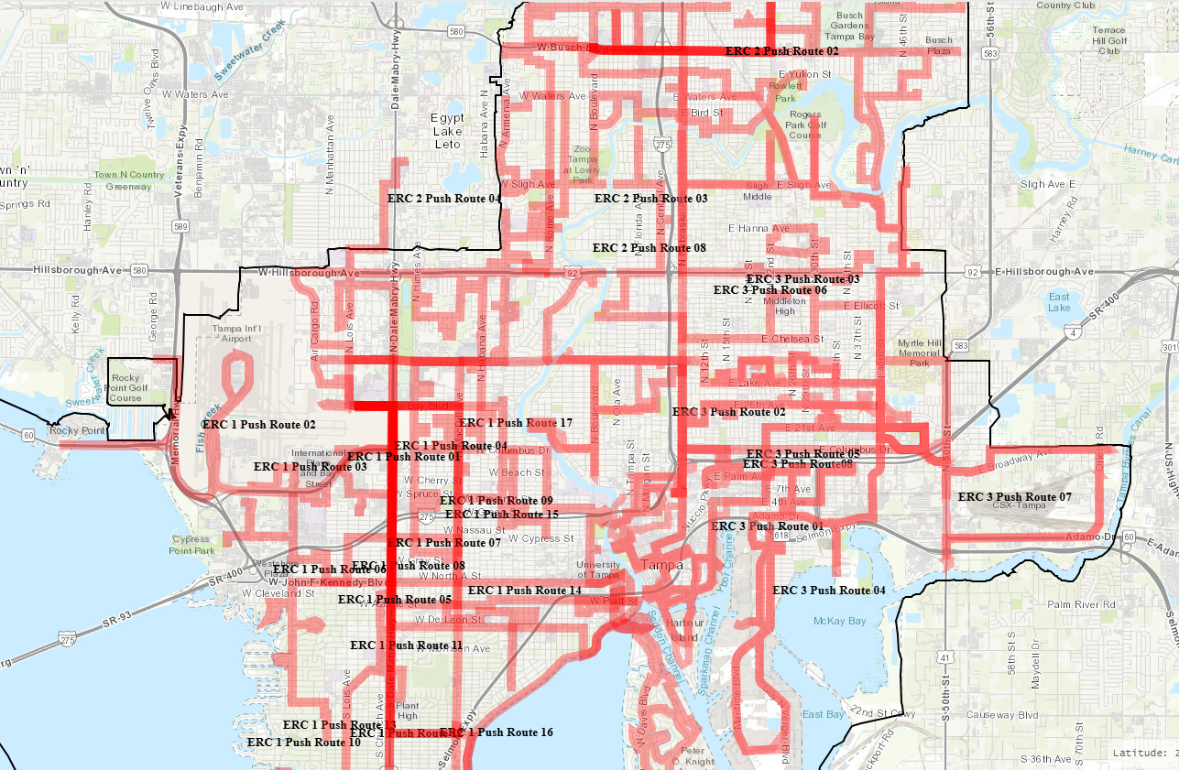
Preconfigured Tasks
Push Crews
1 task for each Push Route
33 Routes in Total
Routes are Assigned to ERC Teams
Form: Initial Damage Report Form
Public Damage Assessment
1 task for each Assessment Route
Buildings are assigned to routes
Routes are Assigned to ERC Teams
Form: Public Damage
Private Damage Assessment
1 task for each ERC
Form: Residential Damage

Slide 9
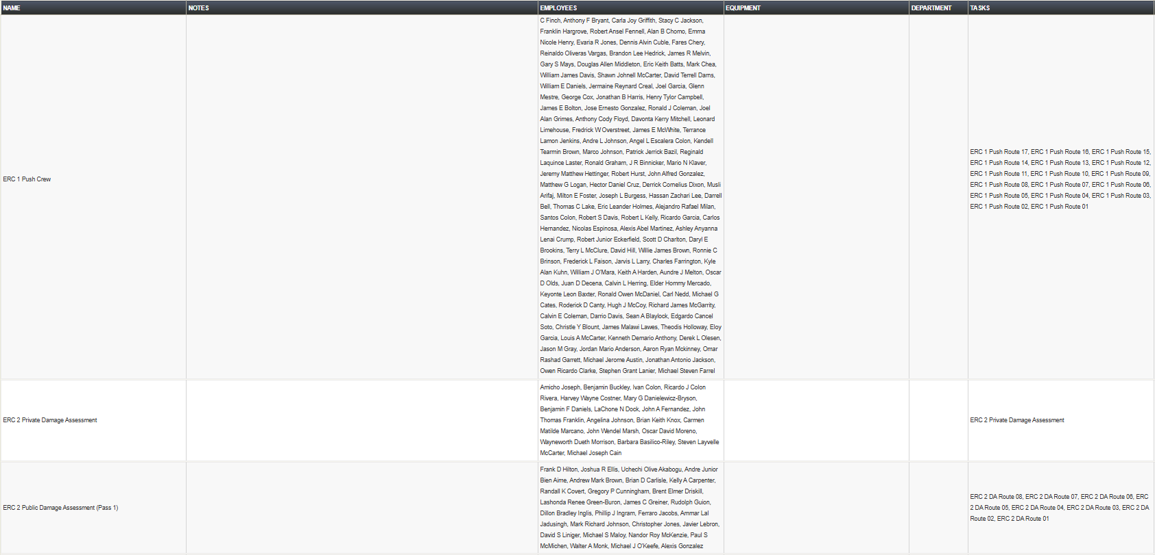
Final Product

Slide 10
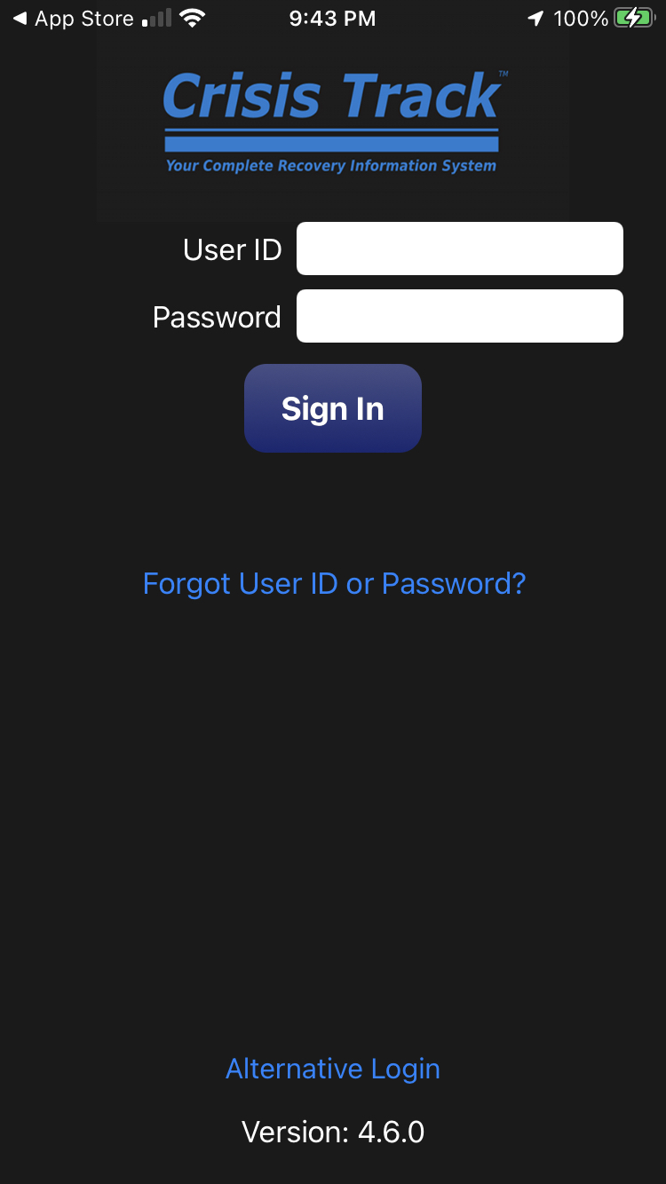
User Experience
KEEP IT SIMPLE!!!
Will look slightly different on Android or Apple.

Slide 11
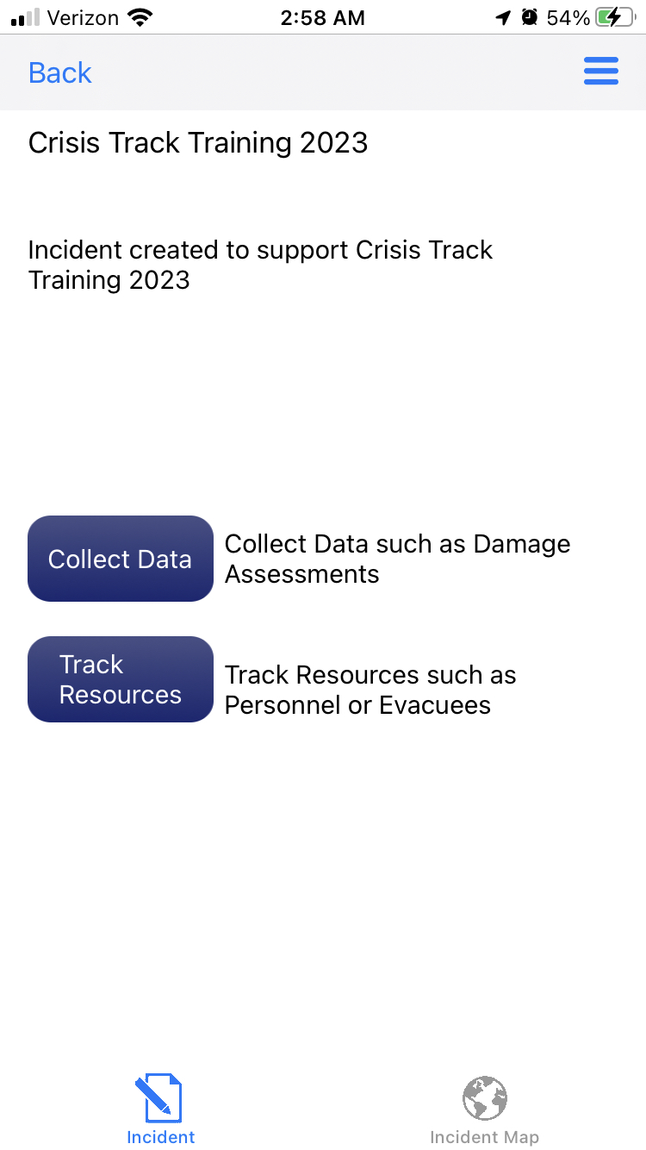
User Experience
Collect Data
Select the Incident.
Select Collect Data.

Slide 12
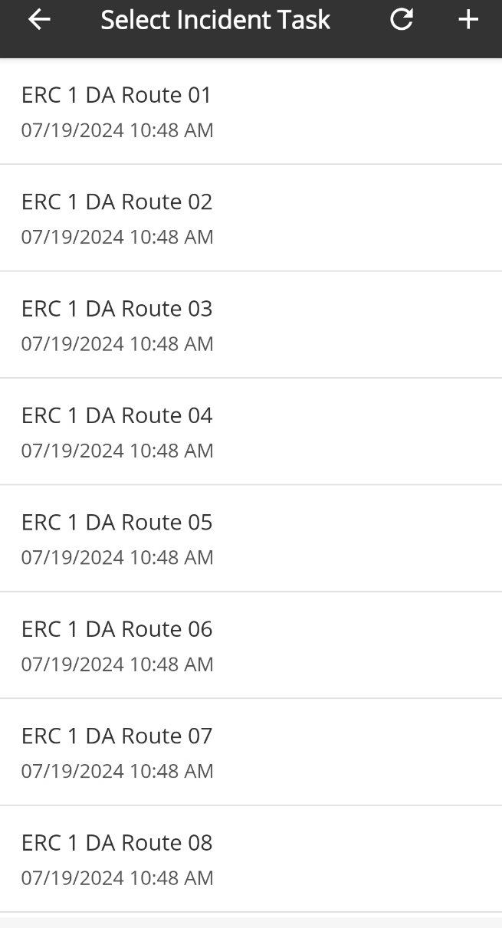
User Experience
Team and Task
Select Team.
Should only be one option.
Select the Task.
The route they have been assigned.

Slide 13
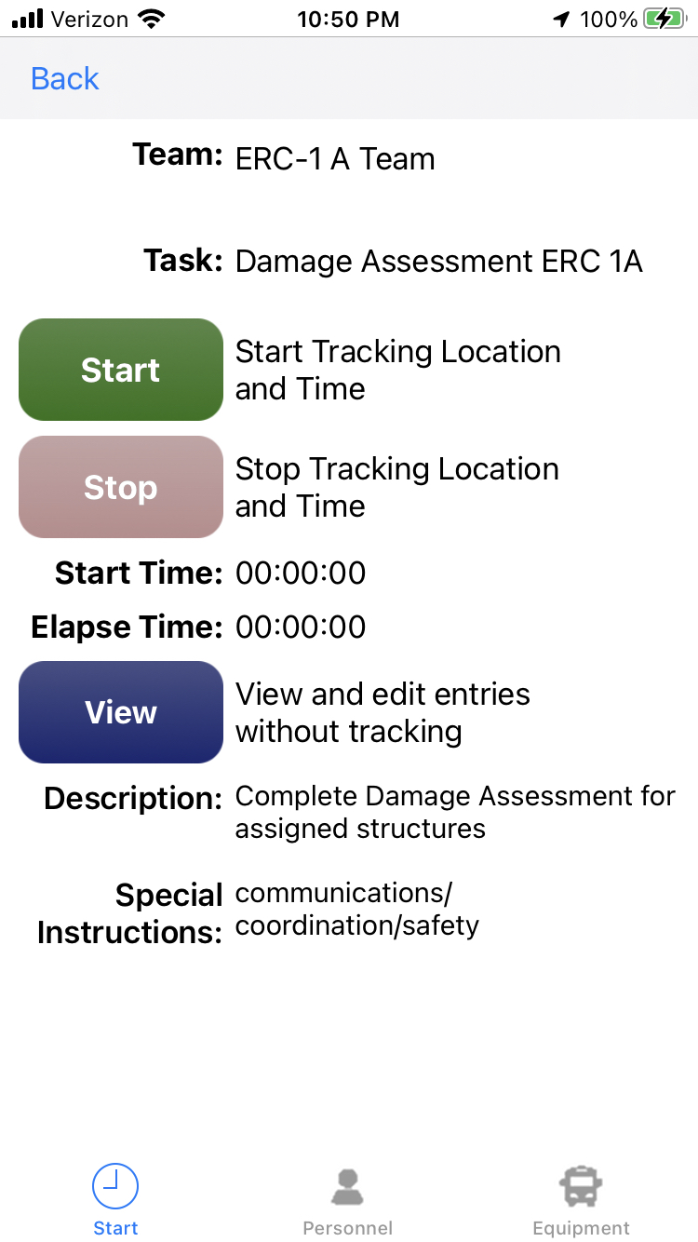
User Experience
Begin Tracking
Only one person on the team should push “Start”.
Will track time worked
Will use GPS to track location and map route
All other team member should click “View” to get the next screen.

Slide 14
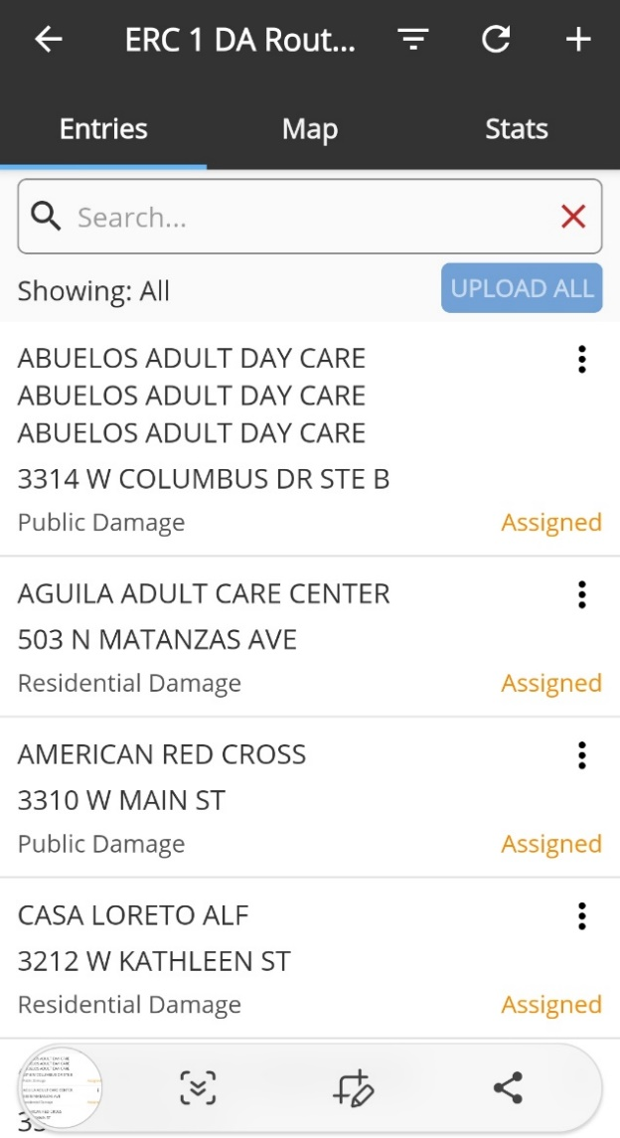
User Experience
Assigned Structures
You will go to a screen with the structures assigned to you team.
Select Structures to complete their assessment.

Slide 15
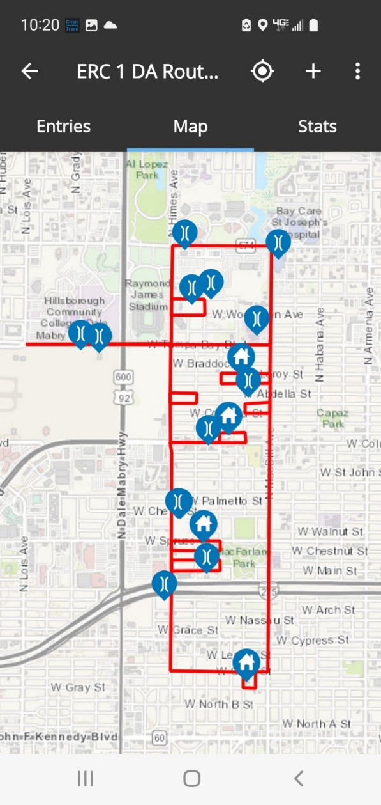
User Experience
Map Function
Shows Route
Shows Facilities

Slide 16
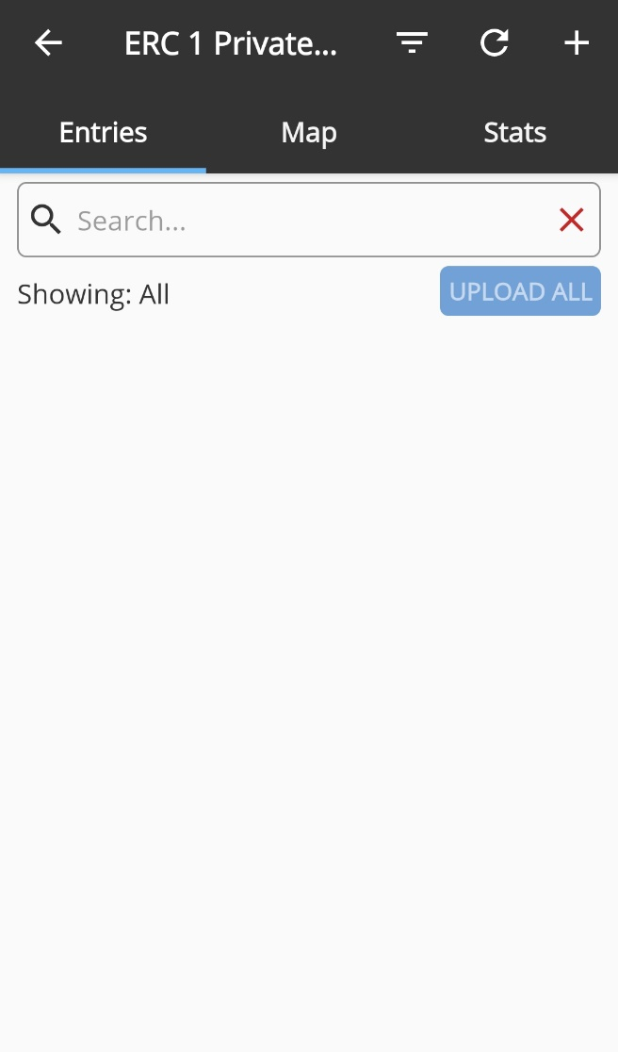
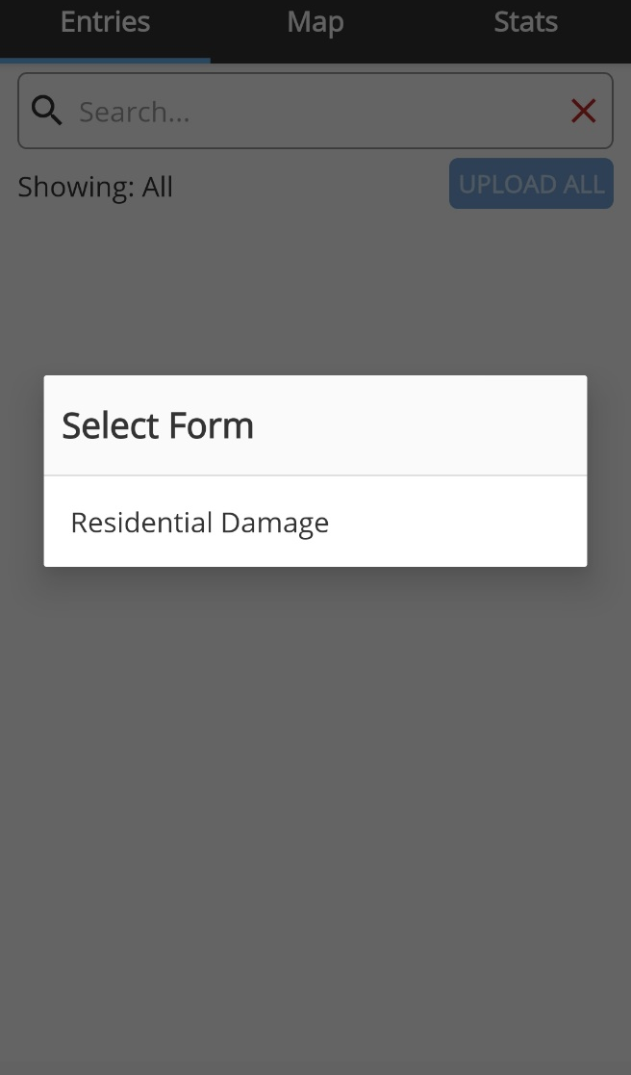
User Experience
Creating New Forms
Form selection options are limited to only those required.
Prevents confusion.

Slide 17
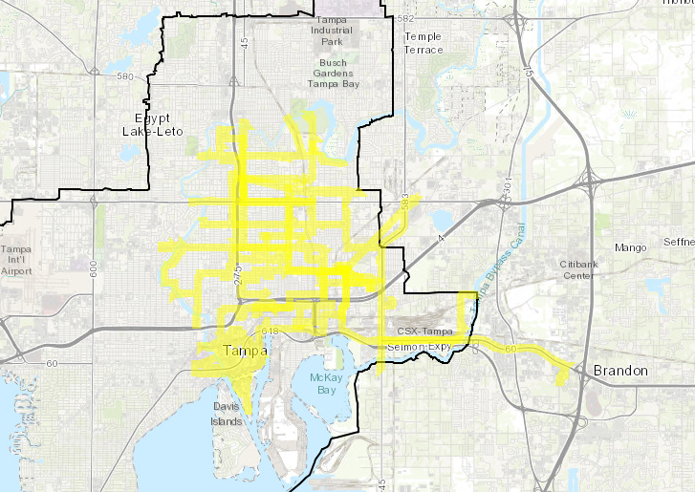
User Experience
Stop Tracking
Select Stop on tracking.
If not, it will follow you home.
Work
Home

Slide 18
2024 Hurricanes
Hurricane Helene
(September 24-27, 2024)
Hurricane Milton
(October 5-10, 2024)

Slide 19
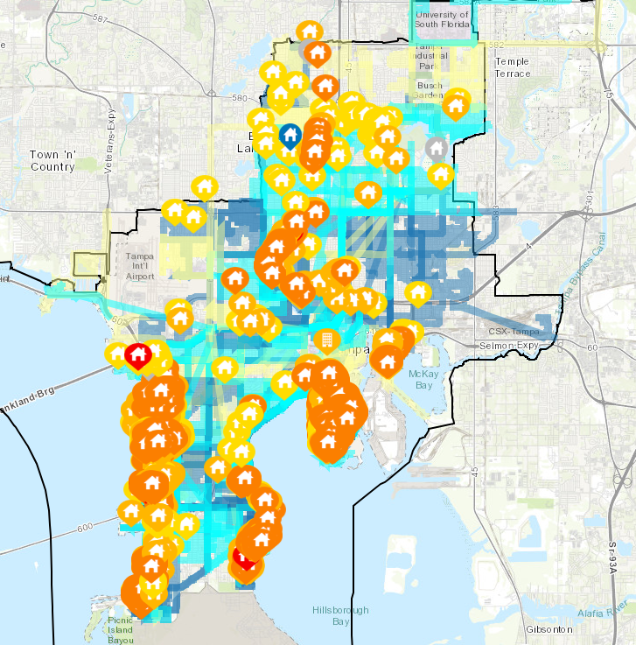
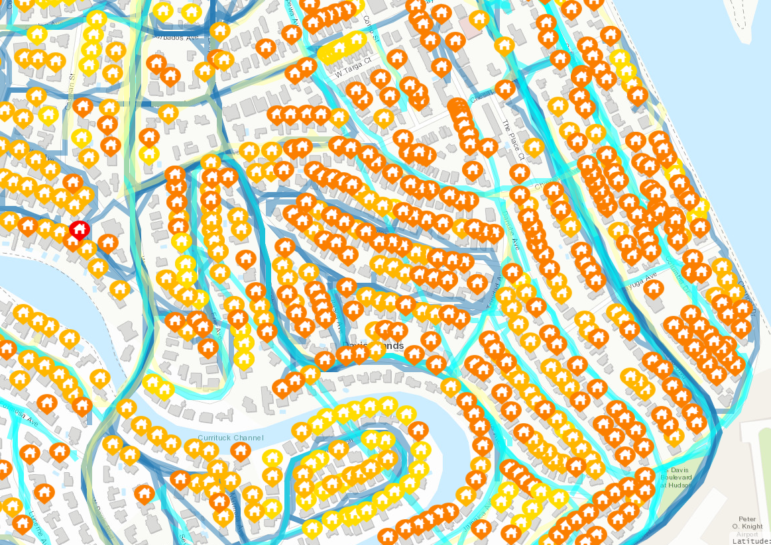
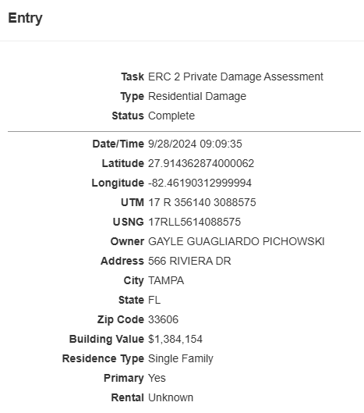
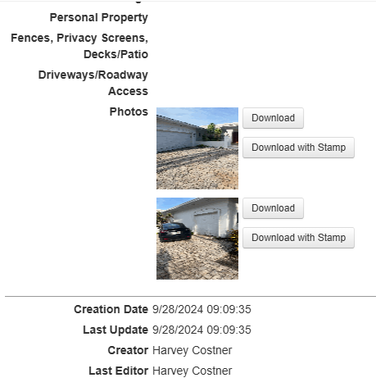
Private Damage Assessment
Helene

Slide 20
Preliminary Damage Assessment - Helene
Completed Preliminary Damage Assessment in 2 days (Sep 27-28)
Affected – 854
Minor – 1,574
Major – 1,944
Destroyed – 34
Approx. $501 million in Private Damage

Slide 21
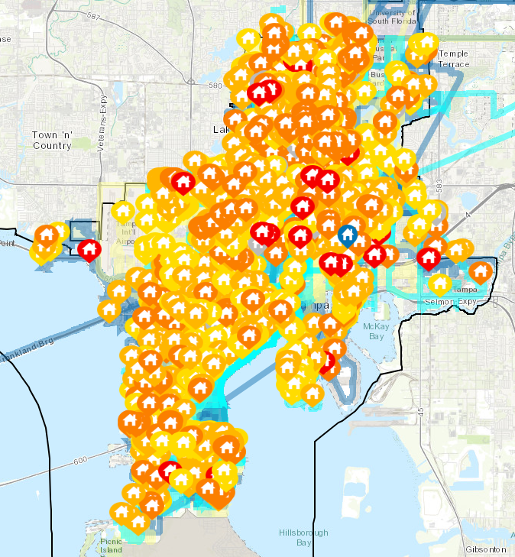
Private Damage Assessement
Milton

Slide 22
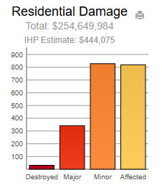
Preliminary Damage Assessment - Milton
Preliminary Damage Assessment Completed in 3 days (October 8-11)
Affected – 819
Minor – 828
Major – 342
Destroyed – 31
Private Damage from Milton
$254,649,984

Slide 23
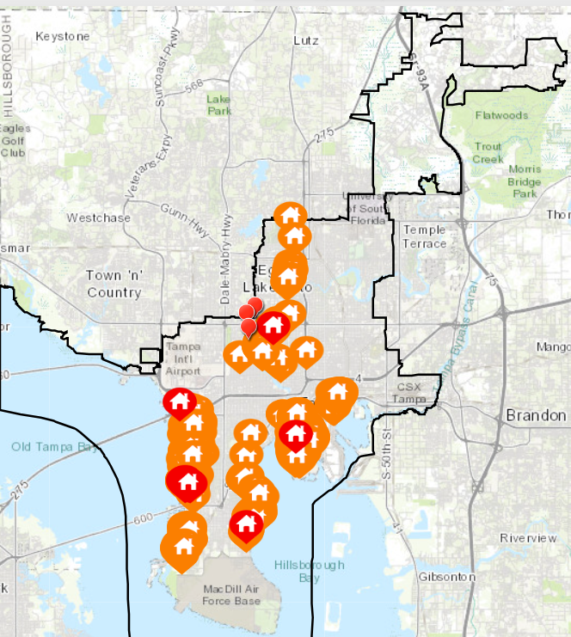
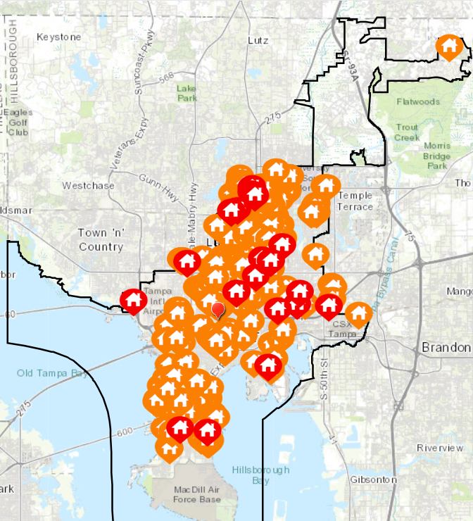
Preliminary Damage Assessment (Helene vs Milton)
Total Private Damage - $754,598,278
Hurricane Helene
Estimated Private Damage - $501,460,185
Hurricane Milton
Estimated Private Damage – $254,649,984

Slide 24
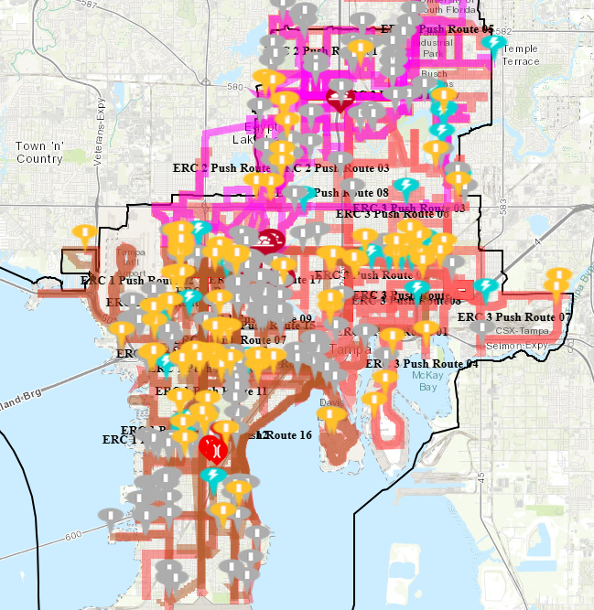
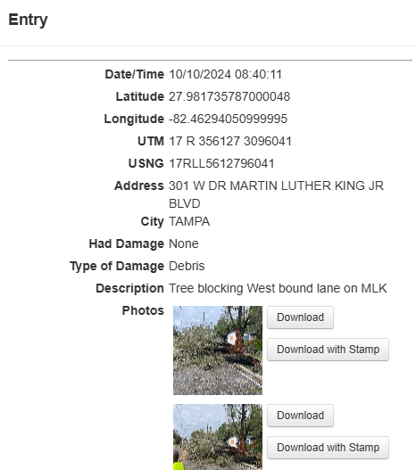
Push Crews
Hazards identified
Helene: 144
Milton: 400

Slide 25
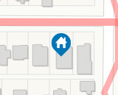
Public Damage Assessment
869 Public Properties to assess.
Categories C - G
Blue - Assigned
Red - Complete
All Properties Completed

Slide 26
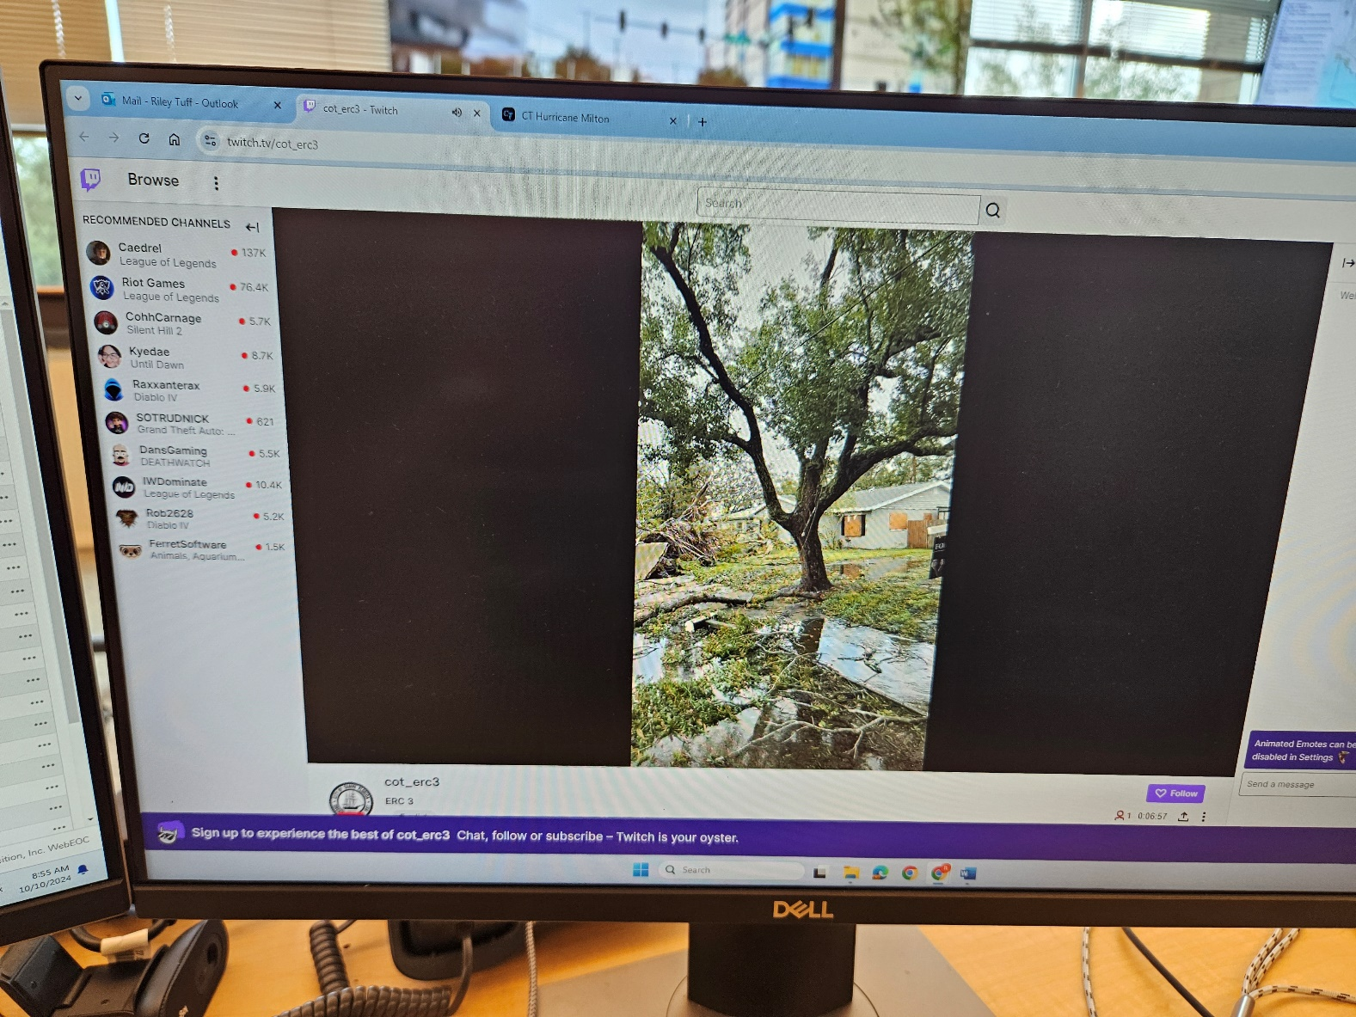
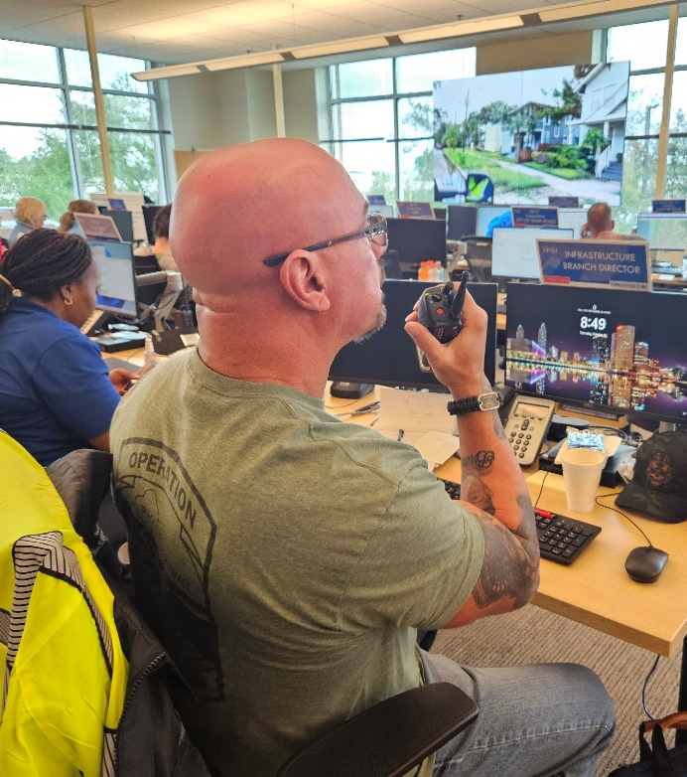
Innovation – Live Steaming Routes

Slide 27
Closing
Crisis Track is incredibly valuable
All Data can be pulled into Excel Sheets
System is overly complicated
MUST BE MADE SIMPLE TO SUCCEED

